Slide 1
SECURE FILE TRANSFER PROTOCOL(SFTP) NOT TO BE CONFUSED WITH SECURE FILE TRANSFER PROTOCOL
Presented by Sujitha & Ranjini Gowri

Slide 2
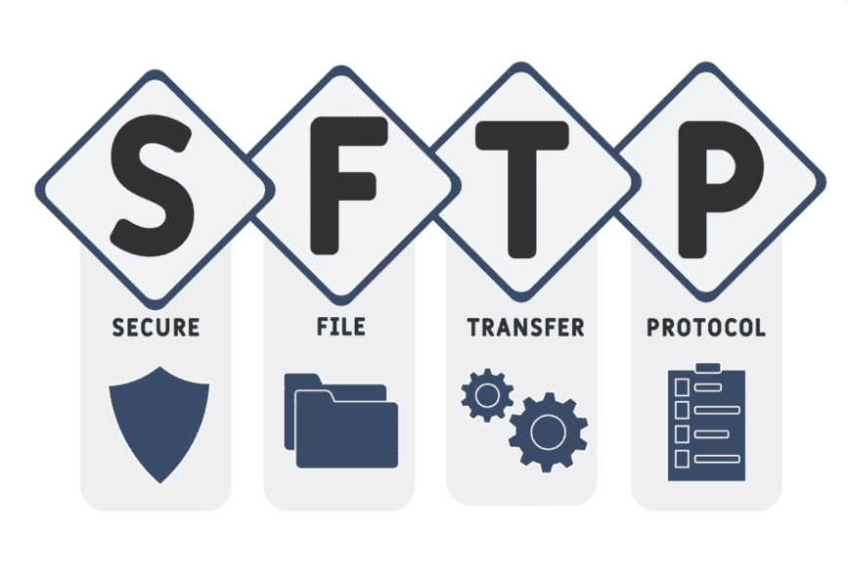

Slide 3


Outline
What is SFTP ?
When we use it ?
Benefits of SFTP
SFTP Implementation and Application
Drawbacks of using SFTP
How to secure SFTP server?
Working of SFTP
Tools of SFTP

Slide 4
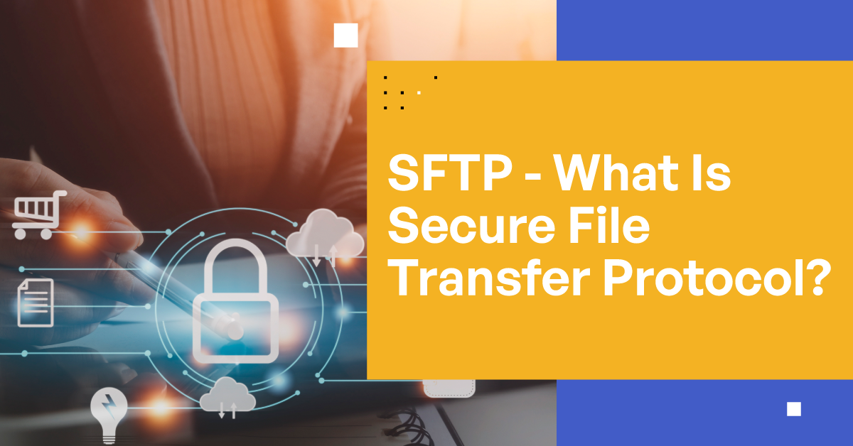

Slide 5

What is SFTP ?
Secure File Transfer Protocol(SFTP) is a network protocol for securely accessing , transferring and managing large files and sensitive data.
Designed by the Internet Engineering Task Force as an extension of Secure Shell(SSH) , SFTP enables access , transfer and management of files over a network.
Commands and Data are encrypted to prevent passwords and other sensitive information from being exposed to the network in plain text.
When we use it ?
Big files , Regulatory transactions , Audits , Sensitive informations.

Slide 6
Benefits of SFTP
Encrypted username/passwords
Encrypted Data Transfers
Prevent users from reading other users FTP data
Prevent full command line access from outside users
Prevent full command line access from any internet facing connection
Allow full command line access to system admin from internal network opening ’SSH’ on port 2222.

Slide 7

Implementations to understand secure data transfer(protocols,software)
openssh-server,/usr/local/etc/sshd_config
Uses SSH-2
wxWidgets:2.8.11
Gnu TLS: 2.10.2
Key authorizations

Slide 8

APPLICATIONS
Filezilla(Open Source) (uses as client)
WS-FTP Pro(client)
Open-ssh(Software)
WinSCP(Windows Client)
FLASHFXP(cloud computing)
SEEBURGER(cloud computing)
Cyberduck(Cloud computing)

Slide 9


Slide 10
Drawbacks of using SFTP
Complexity:
STFP is more complex then FTP,requiring a higher level of technical expertise to set up and use.
Performance:
SFTP can be slower than FTP due to the encryption and decryption process involved.
Limited support:
SFTP is not supported by all FTP clients and servers,which can make it difficult to use in some environments.
Security Issues:
While SFTP is more secure than FTP,it is not immune to hacking or cyberattacks.There have been instances where SFTP systems have been breached.

Slide 11
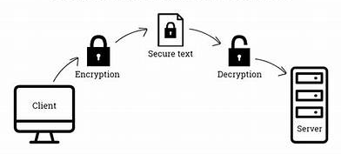
How to secure SFTP ?
Use a strong password(by using capital letters,small letters,special characters. Ex:Geeks123_45#@$Cn#).
Keep a check on the account consistently if there are any unnecessary activities contact your administrator and change the password.
By using a strong algorithm.
Use file security to secure your data.
SFTP server can be secured by using blacklists and whishlists.

Slide 12
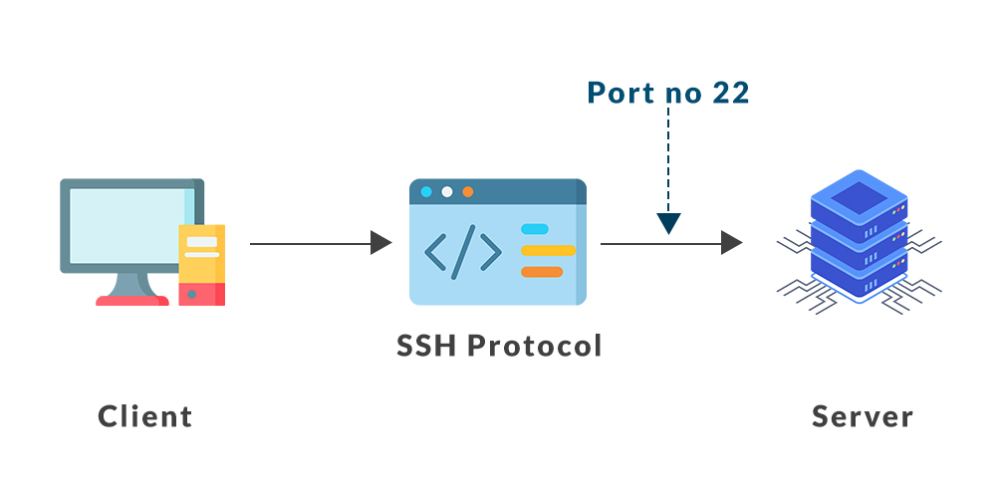
Working of SFTP
SFTP ensures data security by applying SSH Authentication Code(MAC) to data packets. Firstly,a safe and secure connection is established by SFTP then it provides an advances level of protection for data transferring.The authentication of users to the file being shared on SSH data stream,everything is encrypted by SFTP.If any unauthorized person or third party tries too access the data,it will be incomprehensible or unreadable due to encryption.
FOR EXAMPLE: In whatsapp,messages are end to end encrypted.

Slide 13

Tools of SFTP
FileZilla
SFTP
WinSCP
AS2
Cyberduck
CuteFTP
ExaValut
GoAnywhere MFT
MFT
MOVEit
ShareFile

Slide 14


